Slide 1
Introduction to WebSockets
By Sushain Dilishan

Slide 2
Agenda
Http
WebSocket
WebSocket Handshake
WebSocket Use Cases
WebSocket Pros and Cons

Slide 3
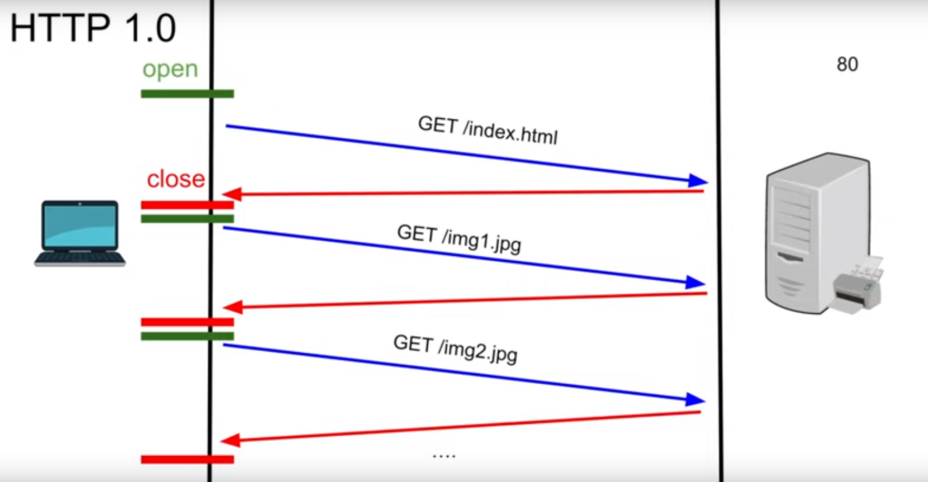
Http 1.0

Slide 4
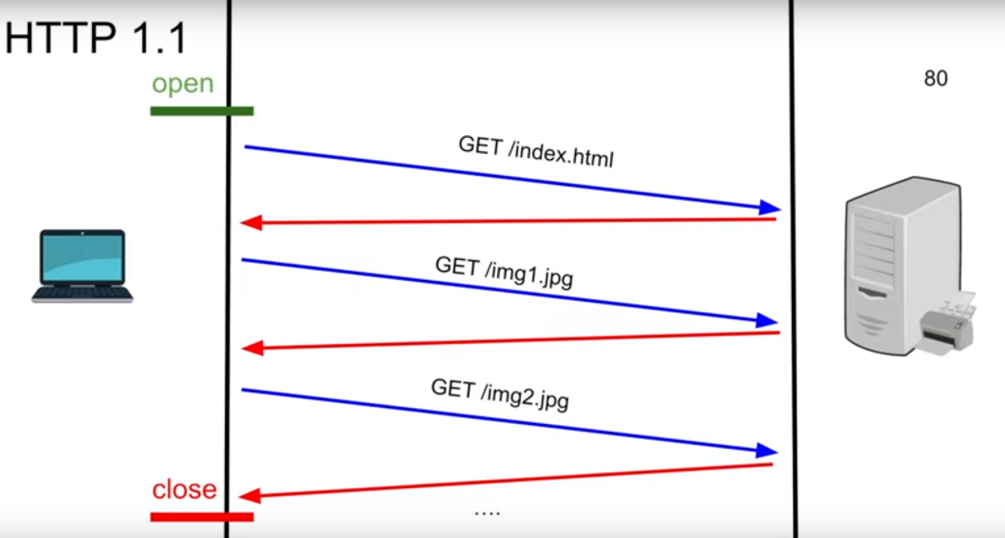
Http 1.1

Slide 5
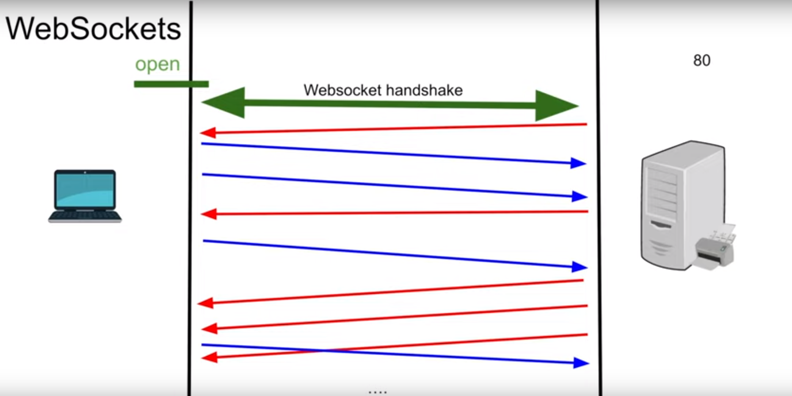
WebSockets

Slide 6
WebSocket Handshake

Slide 7
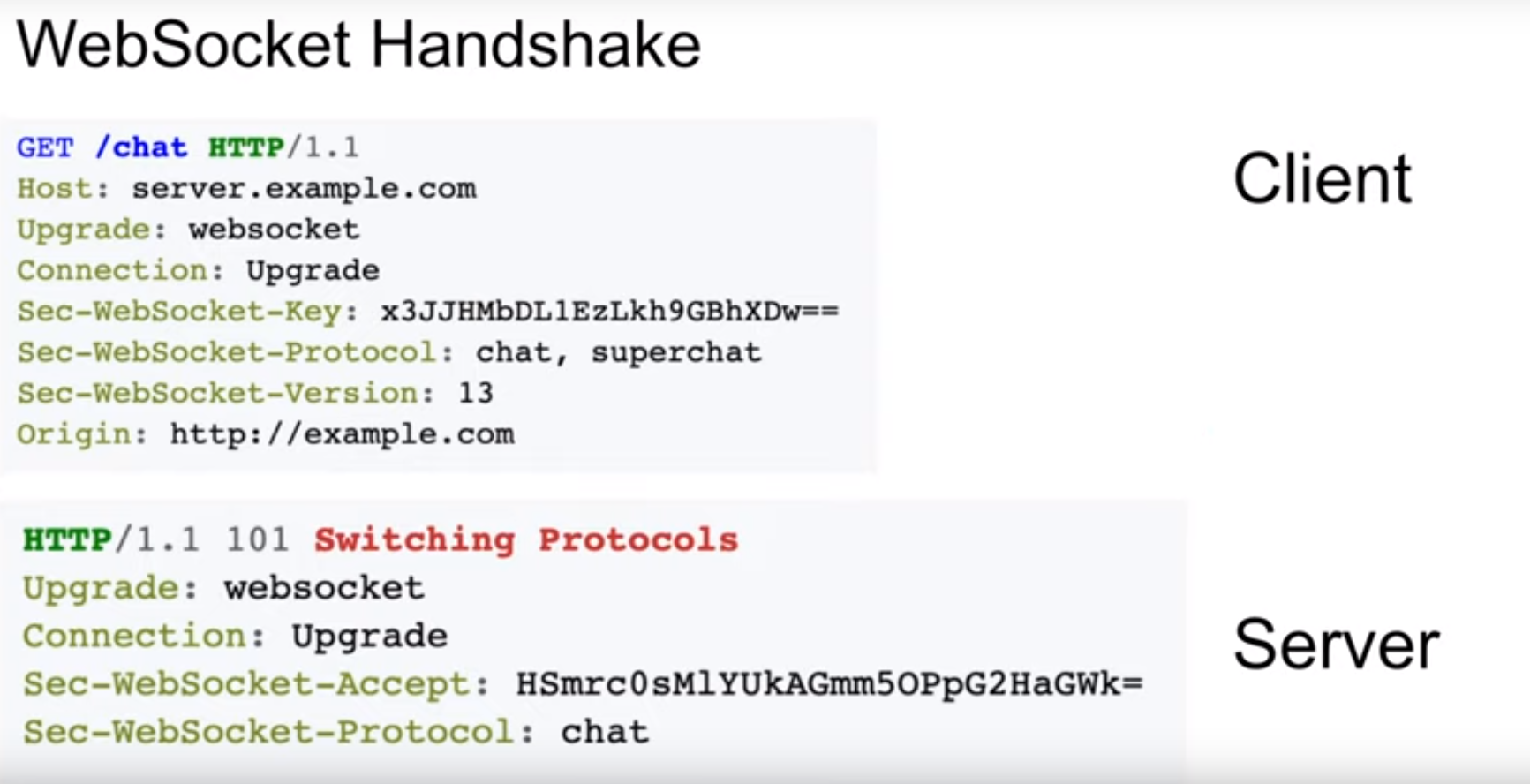
How Header looks like

Slide 8
WebSocket UseCases
Chatting Apps
Live Feed
Multiplayer Gaming
Stock Exchange apps etc…………………

Slide 9
Pros
Full Duplex (no Polling)
Http Compatible
Firewall Friendly

Slide 10
Cons
Load Balancing is Challenging (timeouts)
Stateful, difficult to horizontally scale
Proxying is Difficult

Slide 11

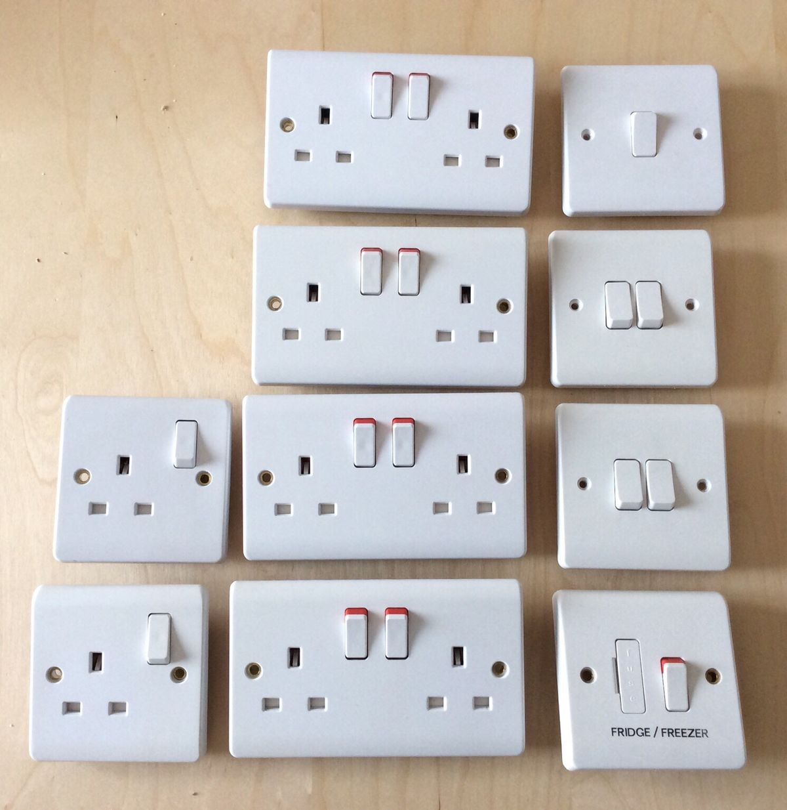
Happy Socket Programming

